Slide 1

Serial 3-D printer
Project Presentation [ME-606 Computer Integrated Manufacturing]
Instructed by – Dr. Keval S. Ramani
Presented by – Team 10
Name | Aayush Vats | Akash Gaurav | Amit Kumar Anand | Anirudha Pratihar
Roll Number | 25263101 | 24263201 | 25263103 | 2206303
Date- 18th November, 2025

Slide 2
Scheme of Presentation
Introduction
Background
Objective
Mechanical Design
Electronics Configuration
Control System
Results
Future Work

Slide 3
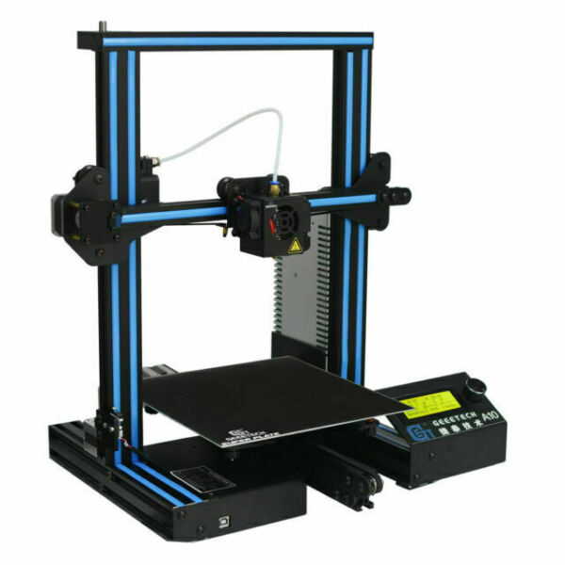
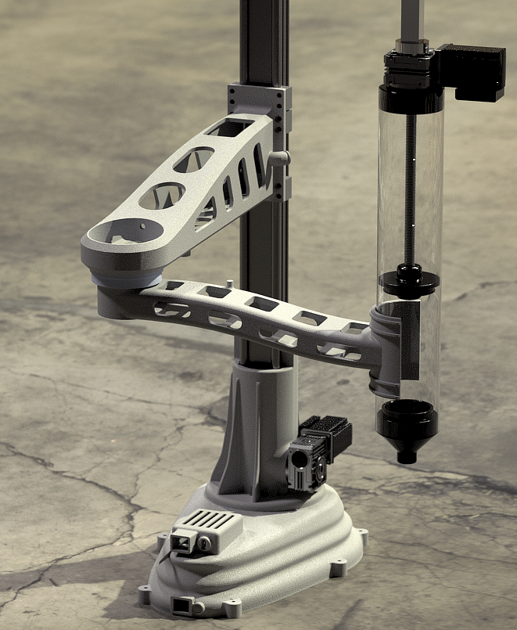
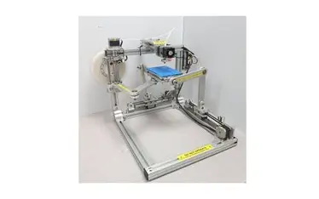
Introduction
3D printers now a days are great source of rapid prototyping.
Some expensive 3D printers are even used to manufacture industrial level materials.
They are of multiple types:
Cartesian (Serial & Parallel)
Delta
Scara
Widely used ones are serial printers.
Figure 1. (a) Cartesian Serial type , (b) Parallel type,(c) SCARA type.

Slide 4
Core Components
Frame: 2020 Aluminium Extrusion for rigidity, Aluminium flat bars, M4 nuts and screws
Motion: Linear Guides, GT-2 Pulley Belts (X & Y), and a Ball Screw mechanism 1mm rod (Z-axis).
Control: Arduino Mega 2560 microcontroller with RAMPS 1.4 shield for 3D printing. A RepRap display, limit switches, Thermistors.
Actuation: 4 Stepper Motors for precise axis movement.
Print Bed: Aluminium sheet with a heat pad.

Slide 5
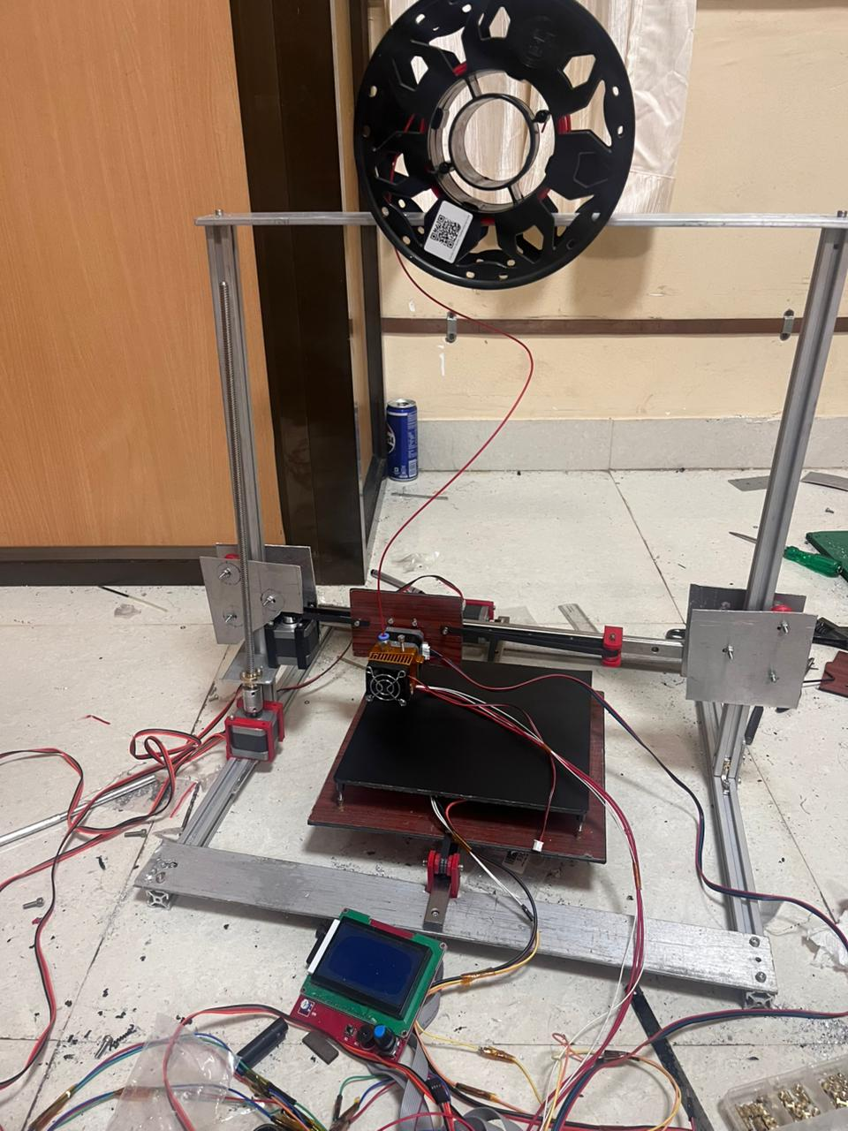
Primary Objectives
To Construct a Serial type 3D printer.
To make a customizable large space for print bed.
To be able to control exactly like an Ender3 printer is being controlled.
Robust structure and precise printing.
Figure 2. Our 3D printer

Slide 6
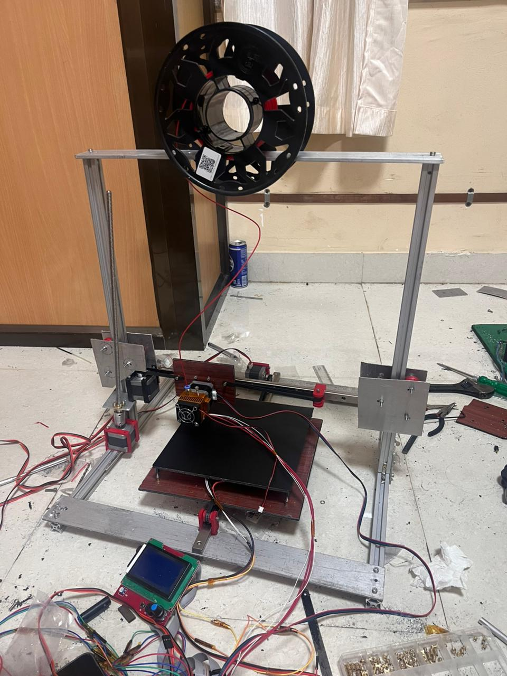

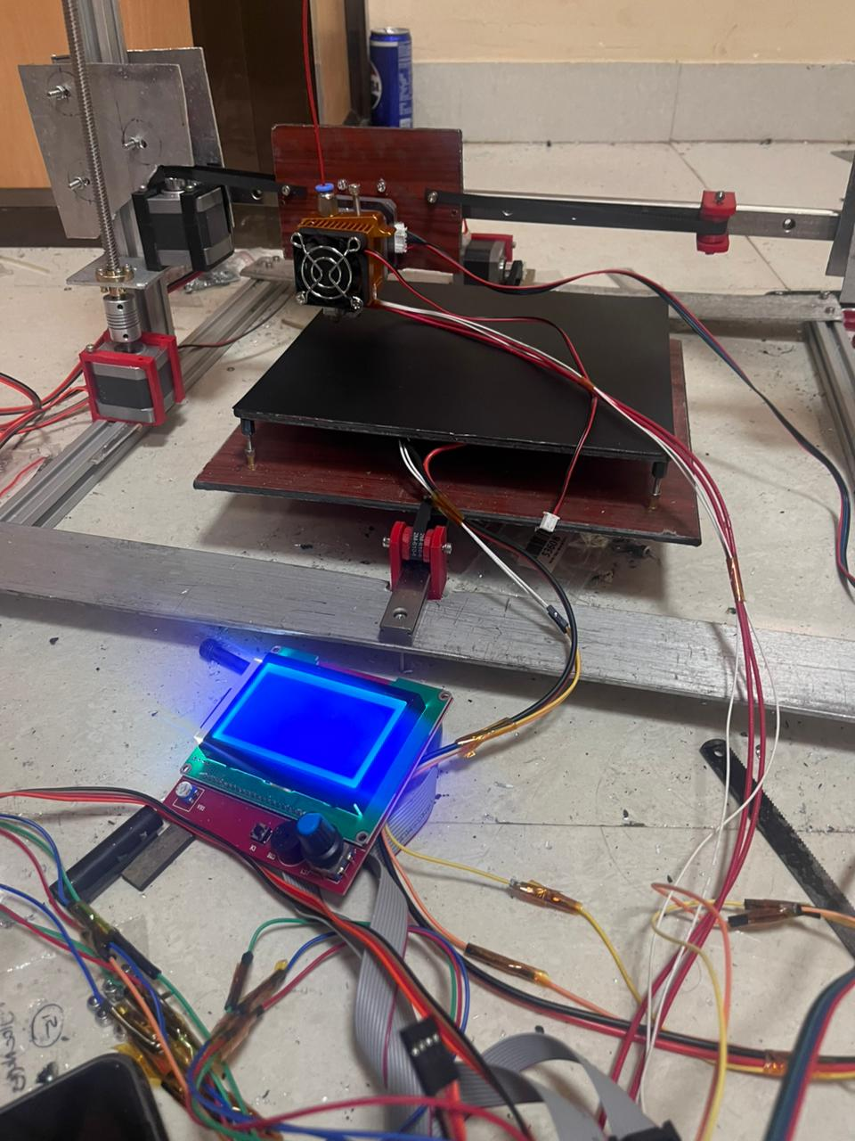
Methodology
Mechanical System Design
Inspiration Ender 3
Four 2020 extrusions Aluminium flat bars.
Tools used: Hand Drill, Filer, Hacksaw, 3D printed prototypes.
Fig. 3 Our 3D printer
Fig. 2 Base frame

Slide 7
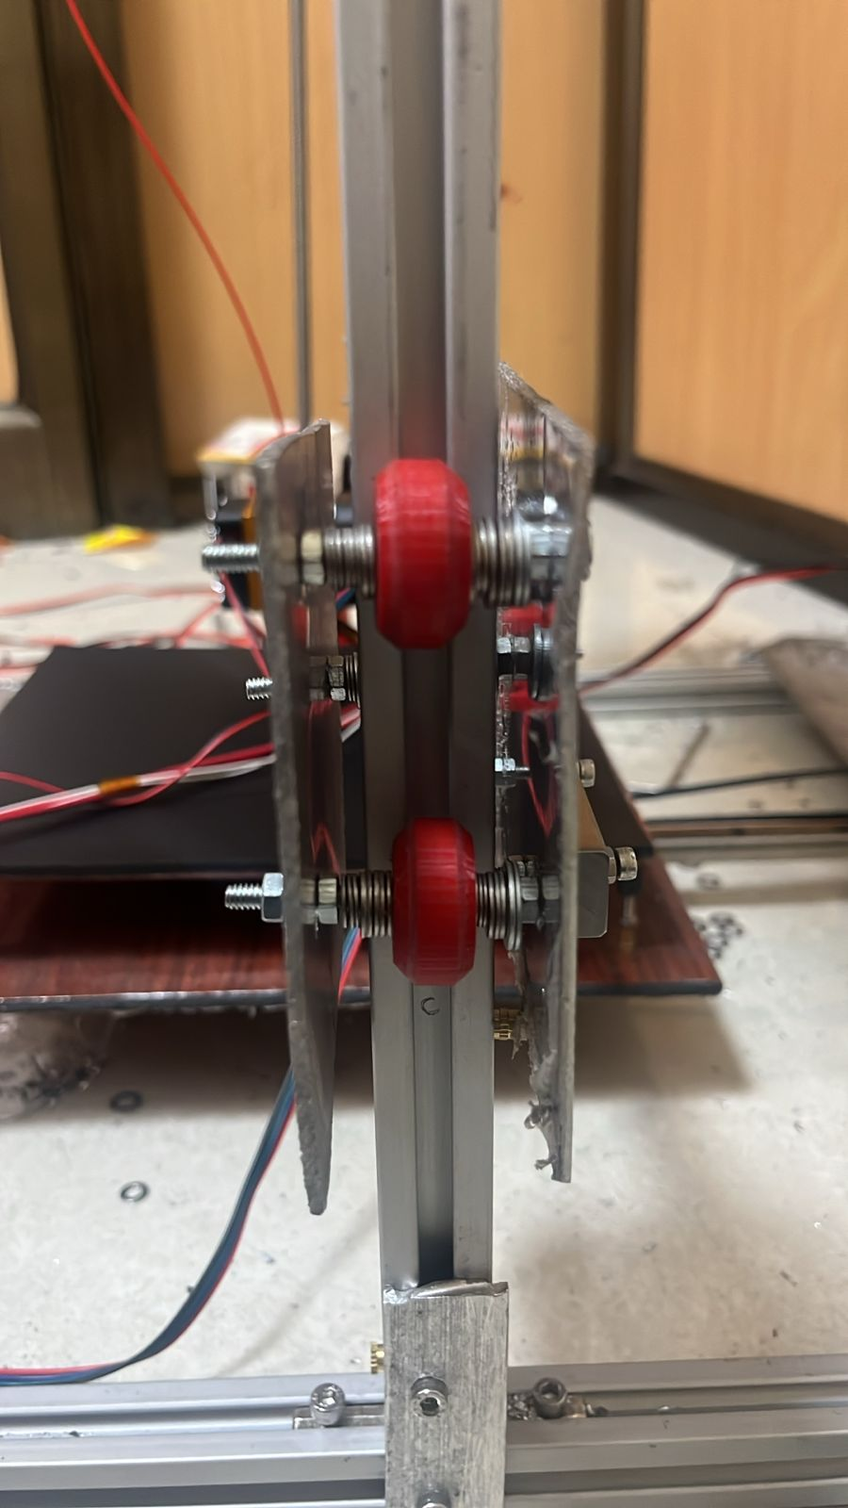
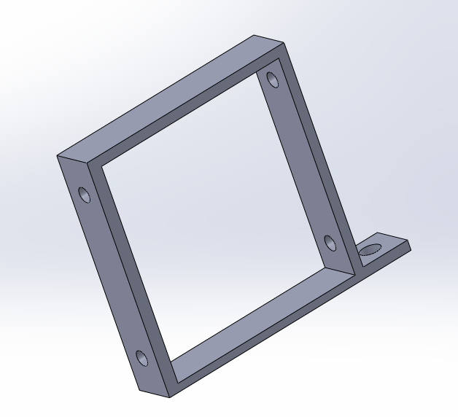
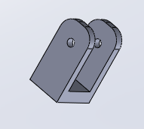
Methodology
Electronics Configuration:
4 motors for motion.
Arduino Mega 2560 with RAMPS 1.4 printer shield acting as the main microcontroller.
Sensors for feedback.
Heat Bed and Extruder.
(a)
(b)
Fig. 4 (a), (b), (c) 3D printed Parts
(c)

Slide 8
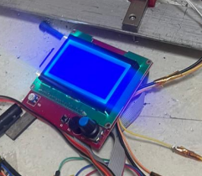
Methodology
Control:
Marlin Firmware used to control the whole printer.
For extra accuracy PID control in all 4 motions is included. The Constants P_{d}, P_{i}, P_{c} already being fine tuned by MARLIN.
PID control also introduced for temperature control of the bed and extrusion nozzle.
RepRap Display acts as the UI for the printer.
User Friendly Knob
Fig. 5 RepRap Display, with user- friendly nob for control

Slide 9
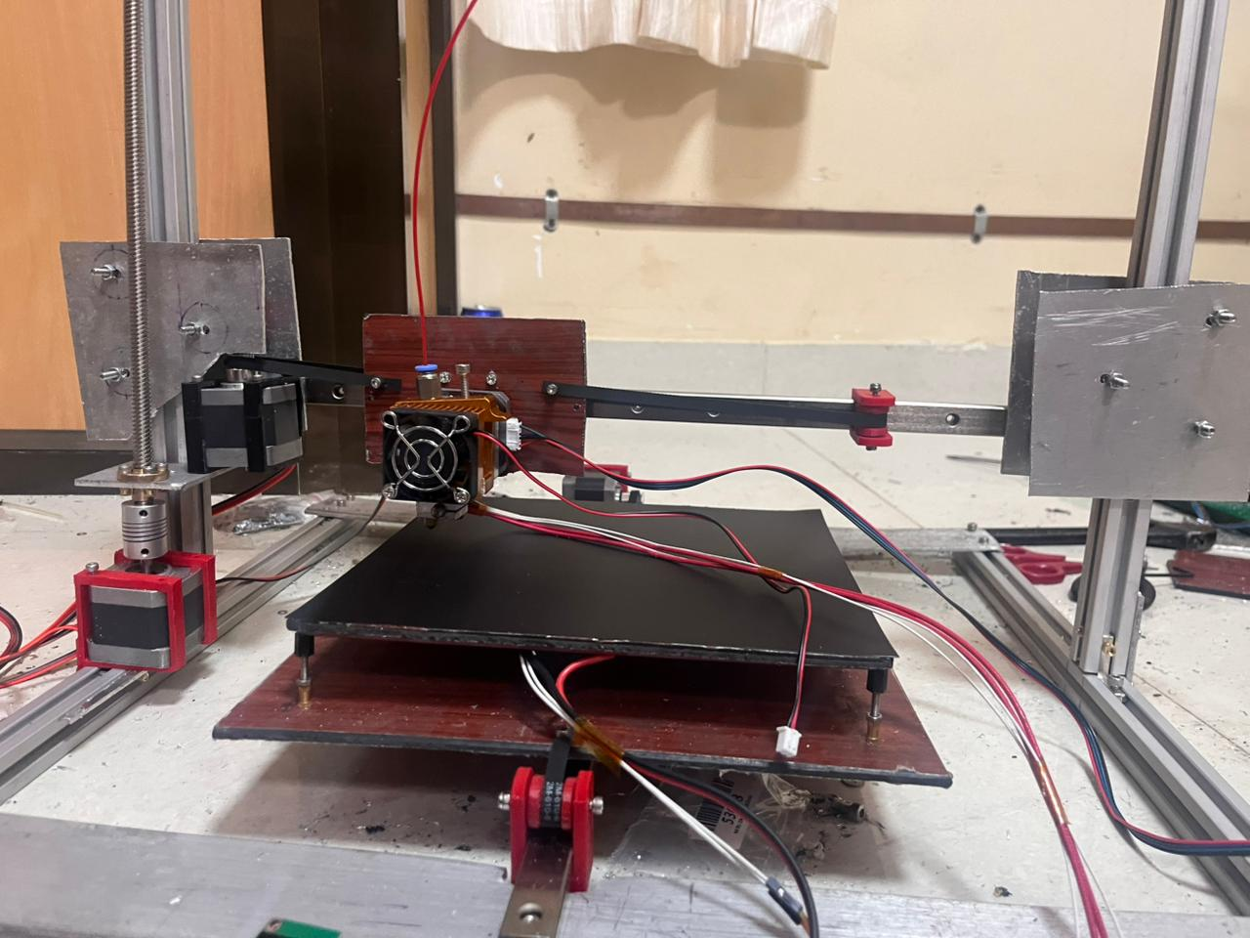
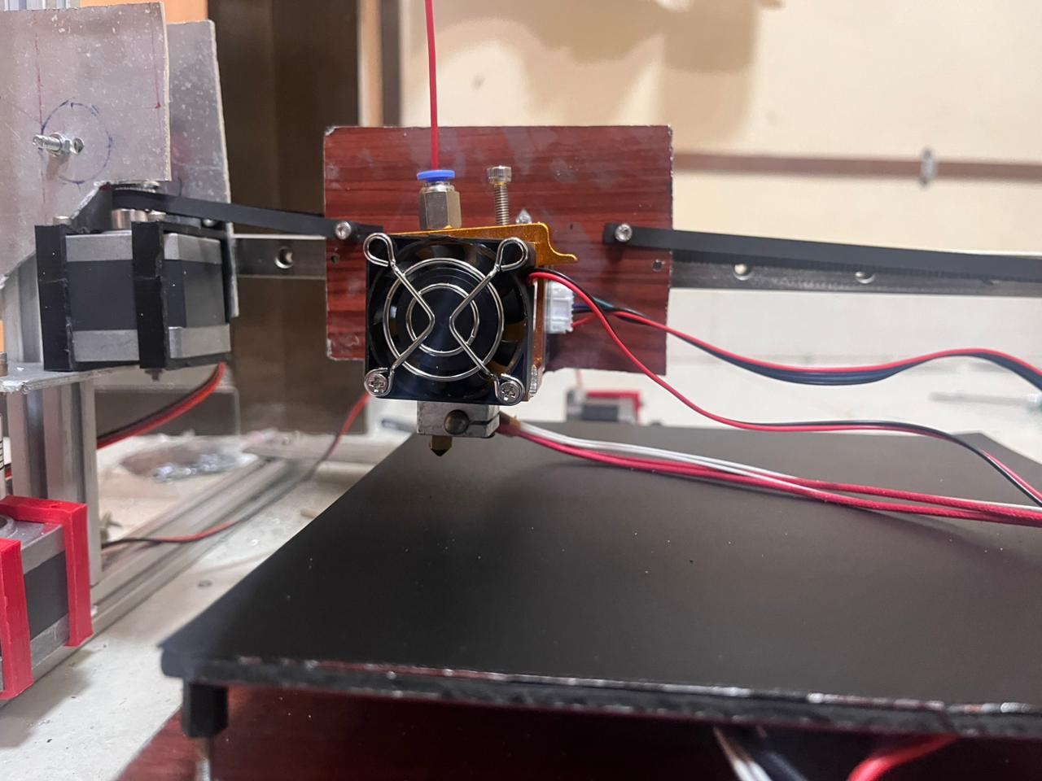
Results
(a)
(b)
Extruder with cooling fan motor
X axis motor
Z axis motor
Fig. 6 (a)Shows the motors controlling z-axis and x-axis. (b) Shows Prusa type Extruder.

Slide 10
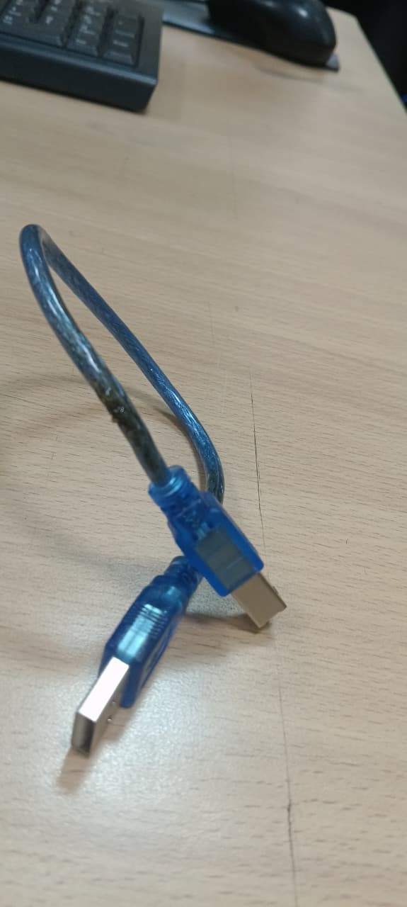
Future Work
The Arduino Mega while running suddenly got short and burnt, thus we couldn’t completely test the motion of the printer. The First work would be to focus on the motion study.
A proper spool for filament handling needs to be attached.
Further study on the workspace area can be done.
Burnt Wire.

Slide 11
Thank-you ☺

